Slide 1
OBJECTIVE
Objective of this NorthWind Project ppt is to do self analysis by exploring data and understanding the matrix. The analysis will give Key performance, sales pattern, order trend ,product analysis and Important Insights which will help to make business growth decision. The Charts will give better visual to understand the business trends with various matrix by which intelligence decision will be possible.

Slide 2
NorthWind Traders
1) Total number of customers by region, country.
2) The top 5 customers by revenue generation.
3) The bottom 5 customers by revenue generation.
1) Top 5 Loyal customers who placed maximum numbers of orders.
2) Customers and Suppliers belong from same country/city.
3) Customers who order every month.
4) Customers who orders from each category.
1) The numbers of order on which discount apply vs not apply
2) Top 5 maximum numbers of order from country.
3) Bottom 5 minimum numbers of orders from country.
4) Average orders per month
1) Numbers of order delivered on time.
2) The numbers of orders from each category.
3) Top 5 orders which generated Maximum revenue.
4) Maximum discount applied on orderid.
PowerBI
Customers
EDA
PowerBI
Orders
EDA

Slide 3
1) The number of employee by region/country.
2) The Numbers of employee by Title.
3) Top 2 employee by highest sales generation.
1) Average age of employee.
2) The numbers of order per employee.
3) Sales generated by each employee.
1) Top 10 most demanded products.
2) Top 5 products by sales.
3) Bottom 5 products by sales.
1) Top 5 products with maximum sales.
2) Top 10 products by Reorder Level.
3) Discount apply on products.
PowerBI
Employee
EDA
PowerBI
Products
EDA

Slide 4
1) Suppliers by region, country ,city.
2) Suppliers by count of category.
3) suppliers have max products by category.
1) Customers and Suppliers belong from same country.
2) suppliers have max products by category.
1) The numbers of order shipped by each shipper.
2) Count of orders by each shippers who has shipped order on time vs after require time.
1) Average days taken by shipper to ship the order.
2) Total Number of orders deliver by each shipper.
PowerBI
Suppliers
EDA
PowerBI
Shippers
EDA

Slide 5
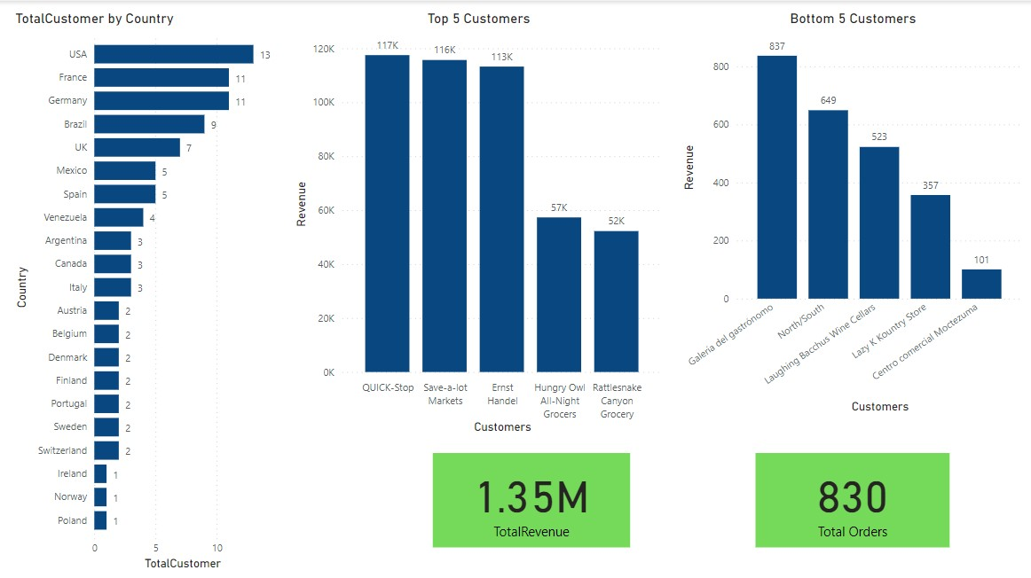
Customers

Slide 6
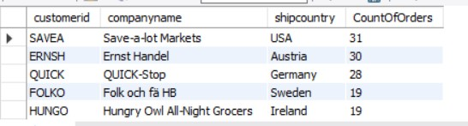
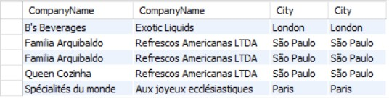
Top 5 Loyal customers who placed maximum numbers of orders
select
c.customerid,c.companyname,o.shipcountry,count(o.OrderID) as CountOfOrders
from customers c
inner join orders o on o.CustomerID = c.CustomerID
group by c.customerid,c.companyname,o.shipcountry
order by CountOfOrders desc
limit 5;
2) Customers and Suppliers belong from same country/city.
select
cu.CompanyName,s.CompanyName,s.City,cu.City
from customers cu left join orders o on o.CustomerID = cu.CustomerID
left join order_details ord on ord.OrderID = o.OrderID
left join products p on p.ProductID = ord.
left join suppliers s on s.SupplierID = p.SupplierID
where s.City = cu.City
Customers

Slide 7
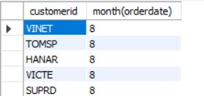
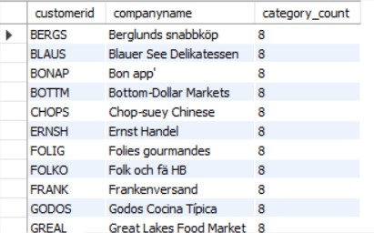
3) Customers who order every month.
select
customerid, month(orderdate)
from orders
Note: NO Customer has placed order every month.
4) Customers who orders from each category.
Select
cu.customerid,cu.companyname,count(distinct p.CategoryID) as category_count
from customers cu inner join orders o on o.CustomerID = cu.CustomerID
inner join order_details ord on ord.OrderID = o.OrderID
inner join products p on p.ProductID = ord.productid
group by 1,2
having category_count = 8

Slide 8
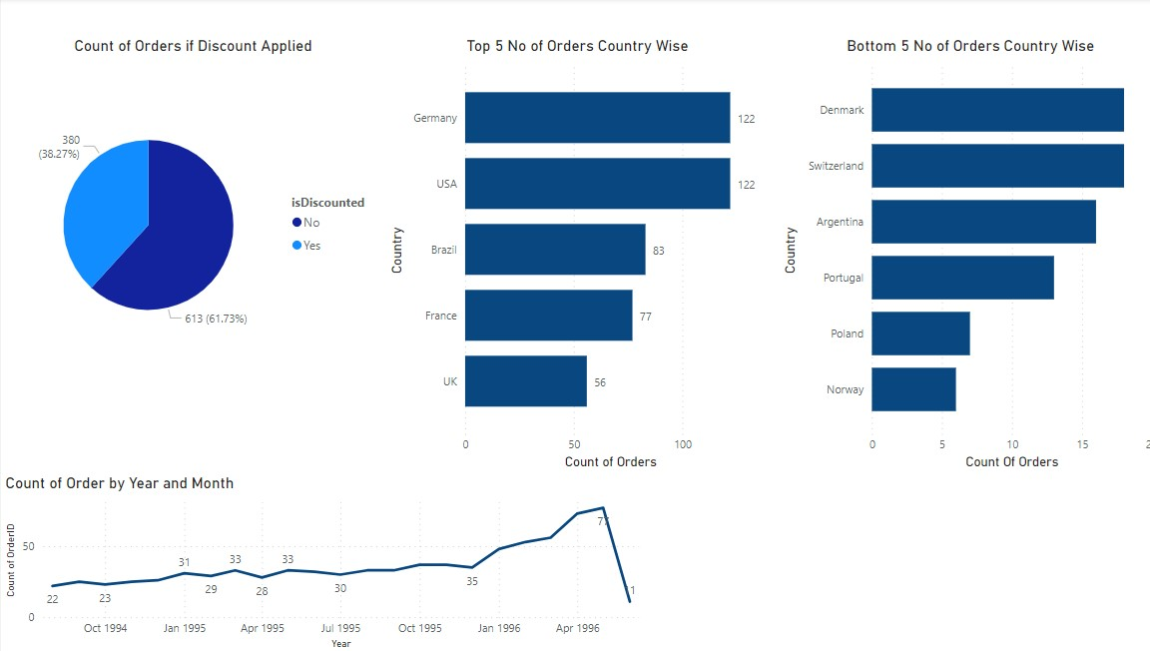
Orders

Slide 9

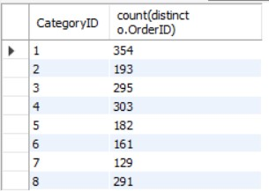
Orders
1) Numbers of order delivered on time.
select count(distinct orderid)
from orders
where ShippedDate <= RequiredDate
2) The numbers of orders from each category.
Select
p.CategoryID ,count(distinct o.OrderID)
from orders o inner join order_details ord on ord.OrderID = o.OrderID
inner join products p on p.ProductID = ord.productid
group by p.CategoryID

Slide 10
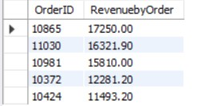

3) Top 5 orders which generated Maximum revenue.
Select
o.OrderID , round(sum(ord.Quantity * ord.UnitPrice),2) as RevenuebyOrder
from orders o inner join order_details ord on ord.OrderID = o.OrderID
inner join products p on p.ProductID = ord.productid
group by 1
order by RevenuebyOrder desc
limit 5;
4) Maximum discount applied on orderid.
Select
o.OrderID,sum(discount) as MaxDiscountOnOrder
from orders o inner join order_details ord on ord.OrderID = o.OrderID
inner join products p on p.ProductID = ord.productid
group by o.OrderID
order by MaxDiscountOnOrder desc
limit 1;

Slide 11
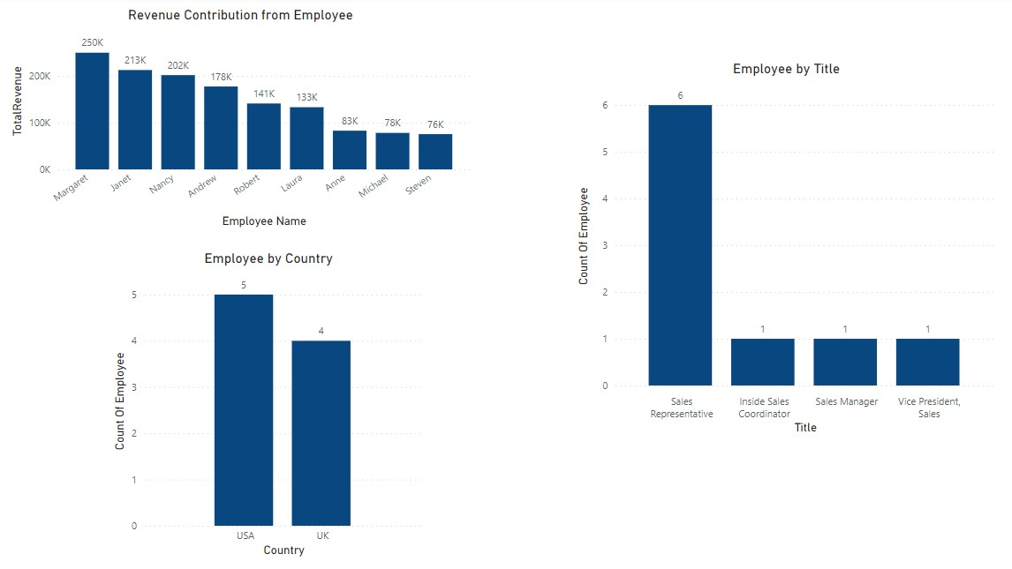
Employee

Slide 12

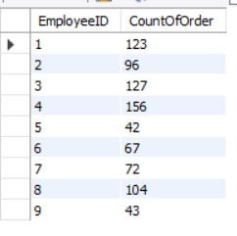
Employee
Average age of employee.
select
avg(year(current_date())-year(birthdate)) as AverageAge
from employees;
2) The numbers of order per employee.
Select
o.EmployeeID,count(distinct o.OrderID) as CountOfOrder
from orders o inner join order_details ord on ord.OrderID = o.OrderID
inner join products p on p.ProductID = ord.productid
group by o.EmployeeID

Slide 13
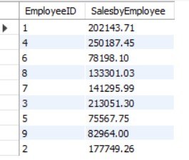
3) Sales generated by each employee.
Select
o.EmployeeID,ROUND(sum(ord.unitprice * ord.quantity),2) as SalesbyEmployee
from orders o
inner join order_details ord on ord.OrderID = o.OrderID
inner join products p on p.ProductID = ord.productid
group by o.EmployeeID

Slide 14
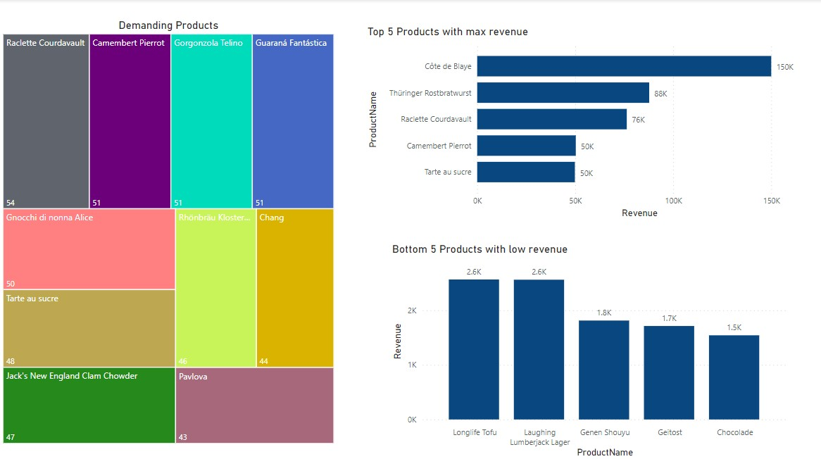
Products

Slide 15
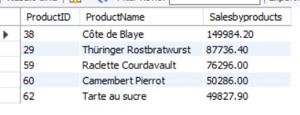
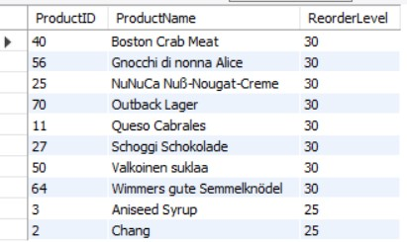
nfnfnfnfnfn
Top 5 products with maximum sales.
Select
p.ProductID,p.ProductName,ROUND(sum(ord.unitprice * ord.quantity),2) as Salesbyproducts
from orders o inner join order_details ord on ord.OrderID = o.OrderID
inner join products p on p.ProductID = ord.productid
group by p.ProductID
order by Salesbyproducts desc limit 5;
2) Top 10 products by Reorder Level.
Select
distinct p.ProductID,p.ProductName, p.ReorderLevel
from orders o inner join order_details ord on ord.OrderID = o.OrderID
inner join products p on p.ProductID = ord.productid
order by p.ReorderLevel desc,p.ProductName
limit 10;
Products

Slide 16
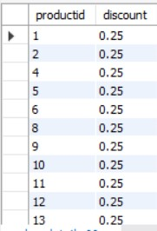
3)Discount apply on products.
Select
distinct productid,discount
from order_detailswhere discount > 0
order by Discount desc, ProductID

Slide 17
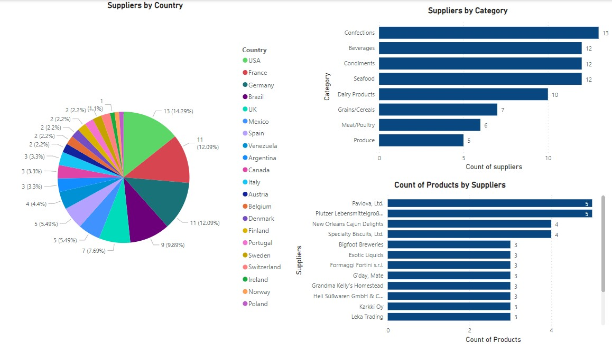
Suppliers

Slide 18
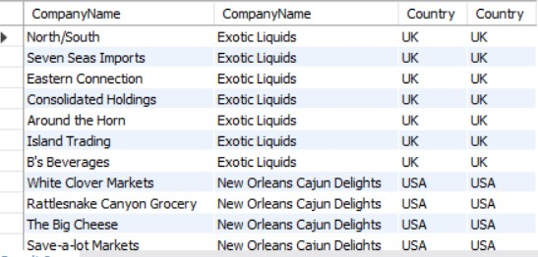
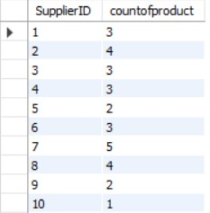
1) Customers and Suppliers belong from same country.
select
distinct cu.CompanyName,s.CompanyName,s.Country ,cu.Country
from customers cu left join orders o on o.CustomerID = cu.CustomerID
left join order_details ord on ord.OrderID = o.OrderID
left join products p on p.ProductID = ord.ProductID
left join suppliers s on s.SupplierID = p.SupplierID
where s.Country = cu.Country
suppliers have count of products.
select s.SupplierID,count( p.ProductID) as countofproduct
from categories c
left join products p on p.CategoryID = c.categoryid
left join suppliers s on s.SupplierID = p.SupplierID
group by 1
order by s.SupplierID
Suppliers

Slide 19
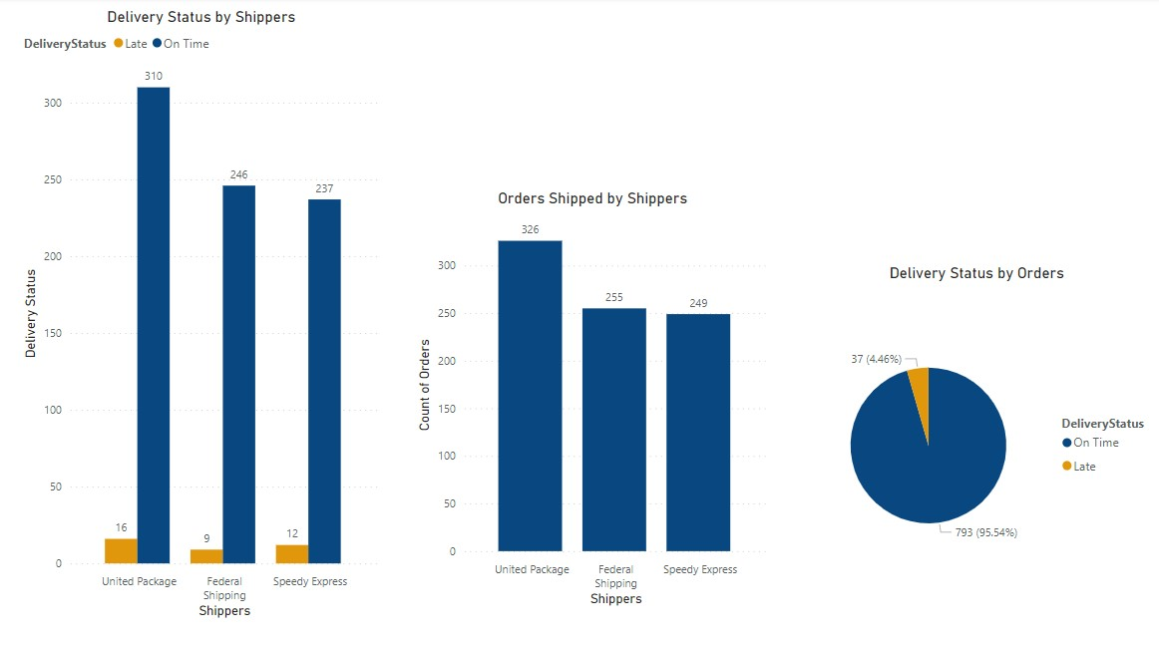
Shippers

Slide 20

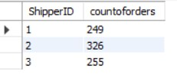
Average days taken by shipper to ship the order.
select
s.ShipperID,avg(datediff(o.shippeddate,o.orderdate))
from shippers s join orders o on o.ShipVia = s.ShipperID
group by s.ShipperID
order by s.ShipperID asc;
2) Total Number of orders deliver by each shipper.
select
s.ShipperID,count(o.OrderID) as countoforders
from shippers s
inner join orders o on o.ShipVia = s.ShipperID
group by 1
order by s.ShipperID
Shippers

